Slide 1
CSI-2 标准 & CSI-2 in 5202(3)

Slide 2
CSI-2 标准协议

Slide 3
outline
Overview
CSI-2 layer definitions
CCI
Physical layer
Multi-lane Distribution and merging
Low level protocal
Color space
Data formats

Slide 4
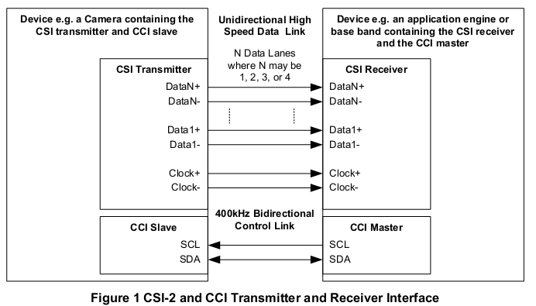
Overview
Camera Serial Interface 2 v1.0
Data transmission interface
Unidirectional differential serial interface
MIPI Alliance Specification for D-PHY
Control interface
CCI , bi-direction control interface compatible with I2C standard

Slide 5
outline
Overview
CSI-2 layer definitions
CCI
Physical layer
Multi-lane Distribution and merging
Low level protocal
Color space
Data formats

Slide 6
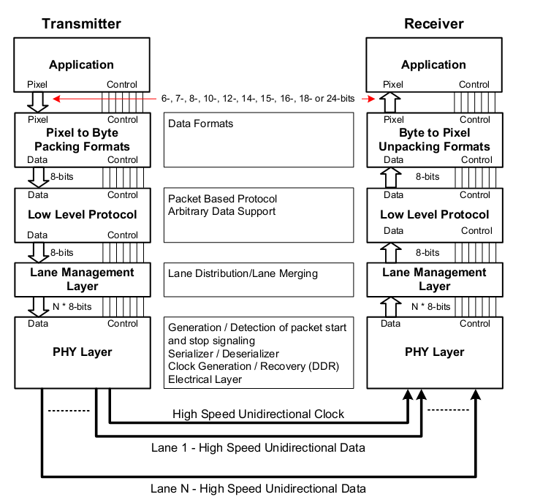
CSI-2 layer definitions

Slide 7
CSI-2 layer definitions
PHY layer
Serial bit stream, synchrnization
Protocol layer
Pixel/Byte Packing/Unpacking layer (tx,rx)
Low level protocol (SoT, EoT and bytes)
Lane management(bytes distribute or merge)
Application layer
Encoding and interpretation of data contained in the data stream.(maping of pixels value to bytes)

Slide 8
outline
Overview
CSI-2 layer definitions
CCI
Physical layer
Multi-lane Distribution and merging
Low level protocal
Color space
Data formats

Slide 9
CCI (Camera Control Interface)
Two-wire, bi-directional, half duplex
Compatible with the fast mode variant of I2C interface
receiver as a master , transmitter as a slave
CCI is a subset of the I2C protocol
contents of control messages is implement dependent
The CCI defines an additional data protocol layer on top of I2C.
[Low Speed]：10Kb/s [Standard Mode]：100Kb/s
[Fast Mode]：400Kb/s
[Fast Mode Plus]：1Mb/s
[High Speed mode]： 3.4Mb/s
Maxima loading 400pf

Slide 10
Data transfer protocol
According to I2C standard
Slave address is 7-bit
8-bit index with 8-bit data or 16-bit index with 8-bit data.

Slide 11
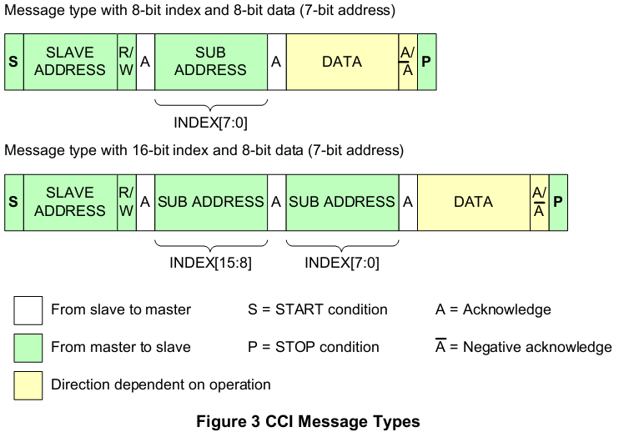
Message type

Slide 12
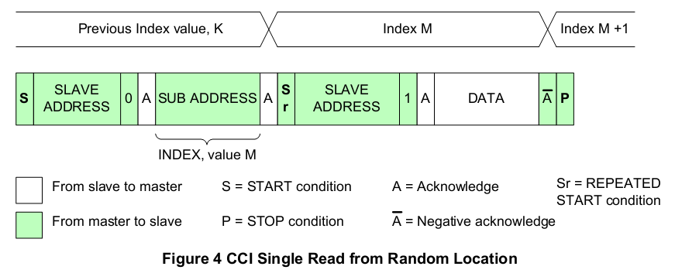
Read/Write Operation single read from random location
Random read

Slide 13
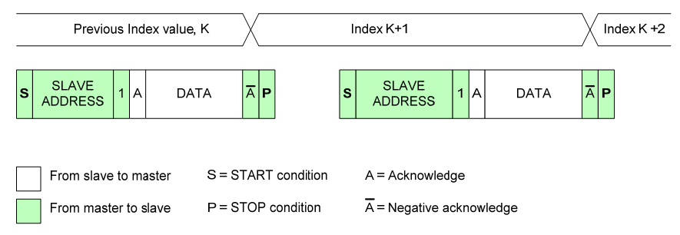
Read/Write Operation single read from Current location

Slide 14
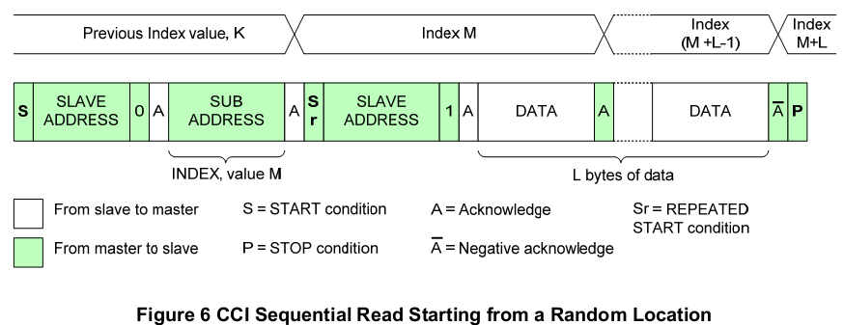
Sequential read

Slide 15
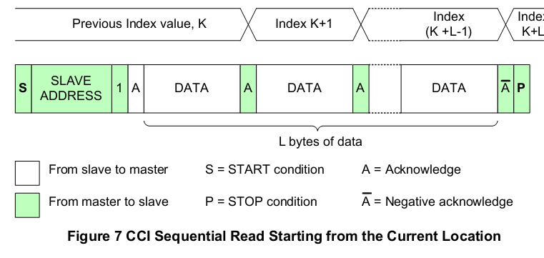
Sequential read

Slide 16
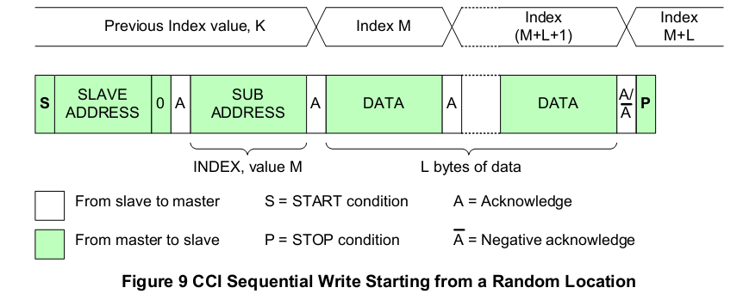
Sequential write
Sequential write from a random location

Slide 17
CCI multi-byte Registers
MS byte of multi-byte register shall be located at the lowest address and the LS byte at the Highest address

Slide 18
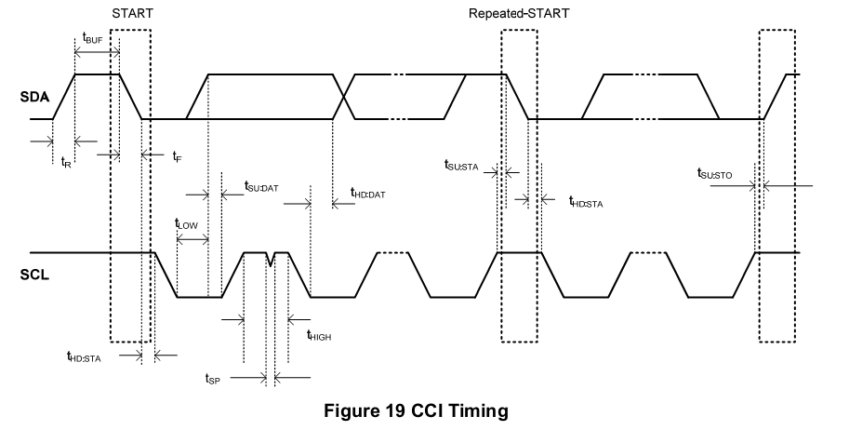
Timing requirment

Slide 19
outline
Overview
CSI-2 layer definitions
CCI
Physical layer
Multi-lane Distribution and merging
Low level protocal
Color space
Data formats

Slide 20
Physical layer
1 to 4 data lane and 1 clock lane
continuous clock , non-continuous clock optional
CSI-2 transmitter
Data Lane Module: Unidirectional master, HS-TX, LP-TX and a CIL-MFEN function
Clock Lane Module: Unidirectional master, HS-TX, LP-TX and a CIL-MCNN function
CSI-2 Receiver
Data Lane Module: Unidirectional slave, HS-RX, LP-RX, and a CIL-SFEN function
Clock Lane Module: Unidirectional slave, HS-RX, LP-RX, and a CIL-SCNN function

Slide 21
outline
Overview
CSI-2 layer definitions
CCI
Physical layer
Multi-lane Distribution and merging
Low level protocal
Color space
Data formats

Slide 22
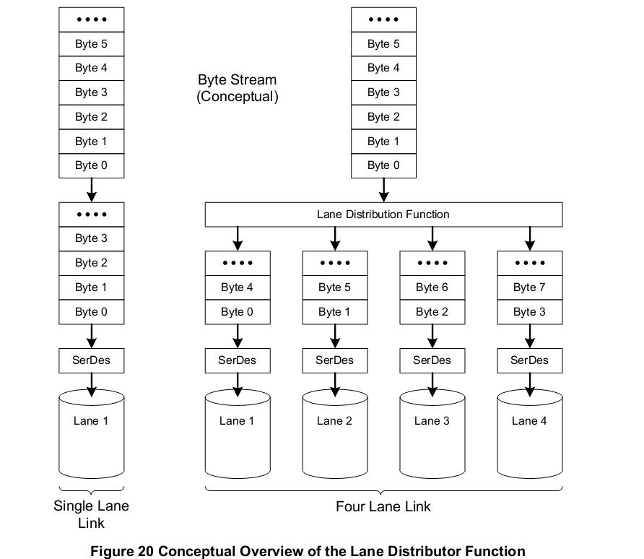
Lane distributing

Slide 23
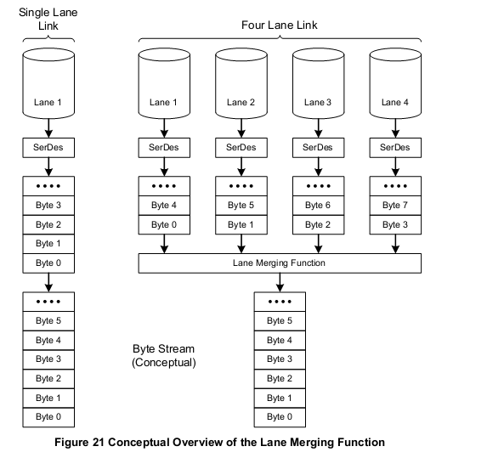
Lane merging

Slide 24
Lane distributor
Arbitrary byte length
Buffers up N bytes(N=number of lanes)
SoT before data, indicate to receiving unit that the first byte of a packet in beginning .
Send groups of bytes in parallel, following a round robin process
Multiple Lanes start simultaneously, may complete at different times. Sending “end packet” codes One cycle(byte) apart.

Slide 25
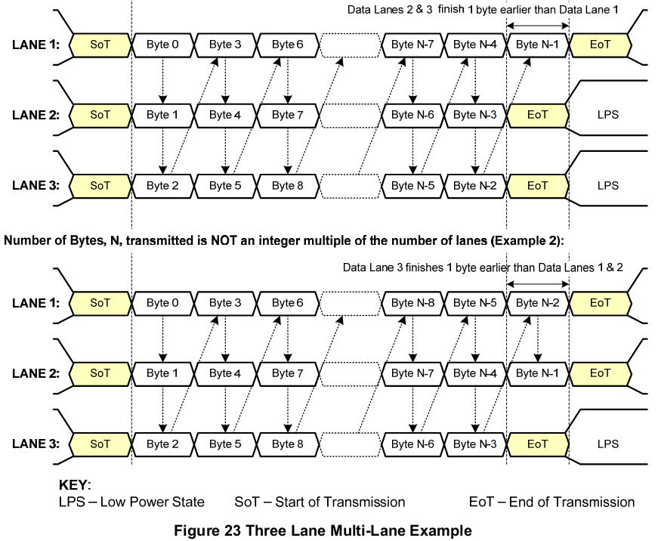

Slide 26
Multi-Lane Interoperability
Reconfigurable via CCI when more than one data Lane is used
N data lane receiver and M data lane transmitter
If M<=N then there is no loss of performance
If M > N then there may be a loss of performance

Slide 27
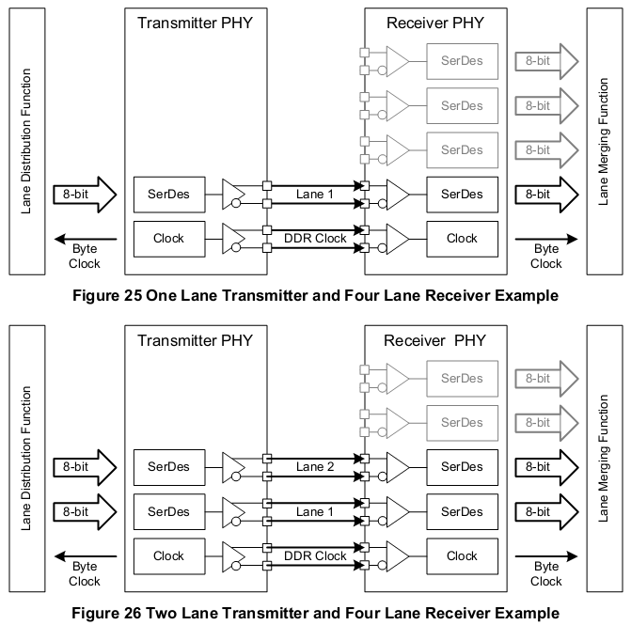

Slide 28
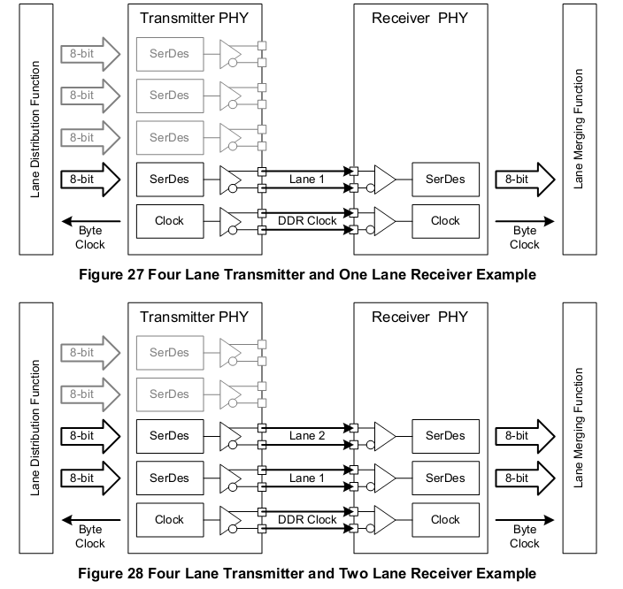

Slide 29
outline
Overview
CSI-2 layer definitions
CCI
Physical layer
Multi-lane Distribution and merging
Low level protocol
Color space
Data formats

Slide 30
Low Level Protocol
Byte orientated
Package based
Feature
Arbitrary data
8-bit word size
Up to four interleaved virtual channels
Special packets for frame start, frame end, line start and line end
Descriptor for the type, pixel depth and format
16-bit checksum code for error detection

Slide 31
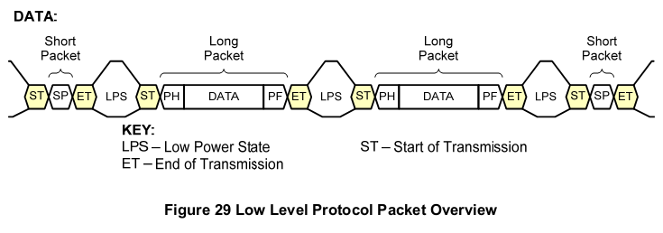
package

Slide 32
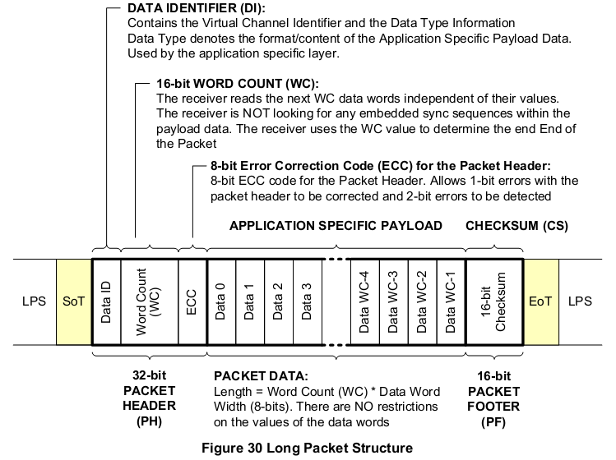
Low Level Protocol Packet Format

Slide 33
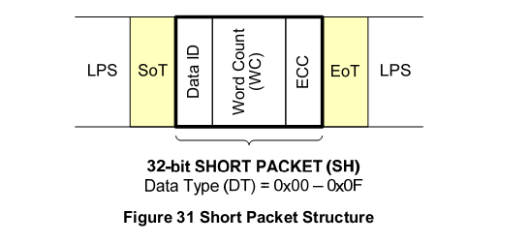
Low Level Protocol Packet Format
The Word Count(WC) field in the Packet Header shall be replaced by a Short Packet Data Field
For Frame Synchronization Data Types the Short Packet Data Field shall be the frame number.
For Line Synchronization Data Types the Short Packet Data Field shall be the line number.
For Generic Short Packet Data Types the content of the Short Packet Data Field shall be user defined.

Slide 34
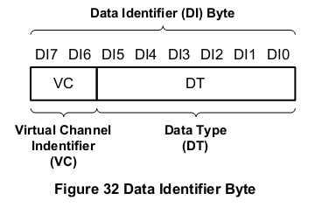
Data Identifier(DI) Byte

Slide 35
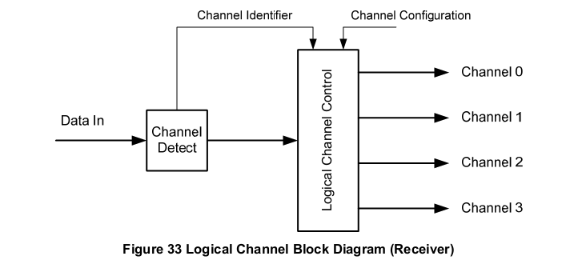
Virtual Channel Identifier

Slide 36
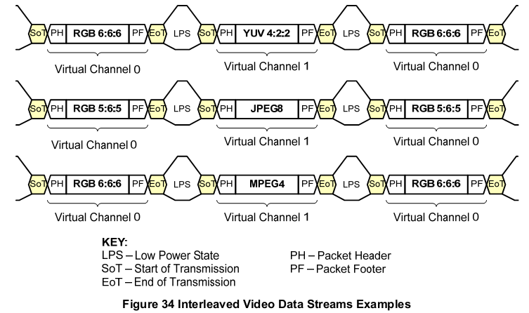
Virtual Channel

Slide 37
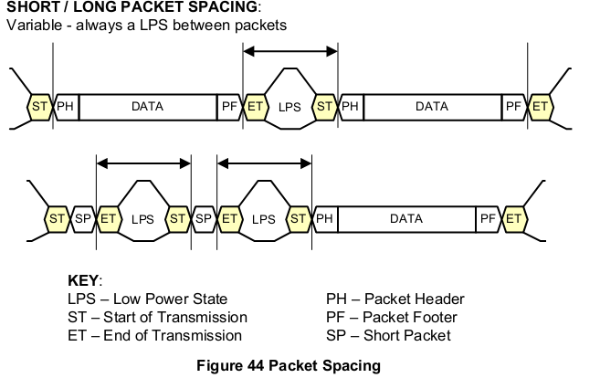
Short/long packet spacing

Slide 38
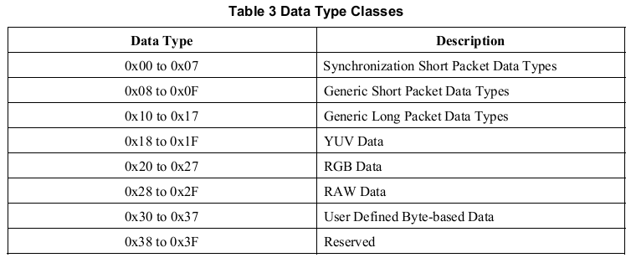
Data Types classes

Slide 39
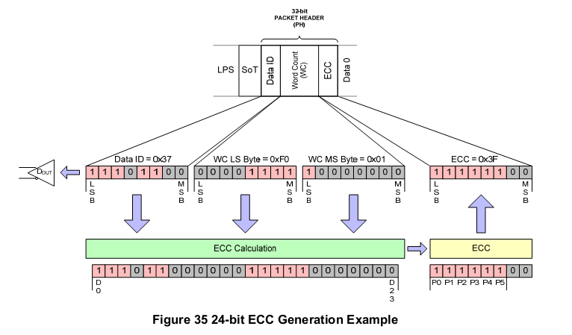
Packet header ECC genatation
7+1bits Hamming-modified code (72,64) and the subset of it is 5+1bits or (30,24).

Slide 40
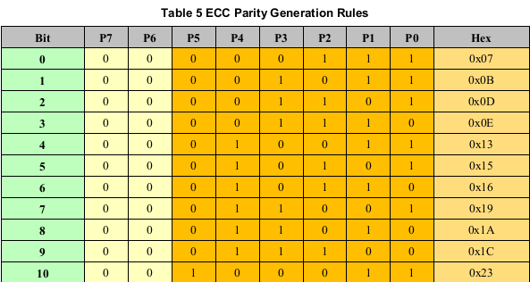
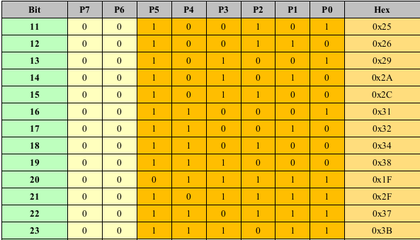
ECC Parity Generation rule
e.g. P0=D0^D1^D2^D4^D5^D7^D10^D11^D13^D16^D20^D21^D22^D23

Slide 41
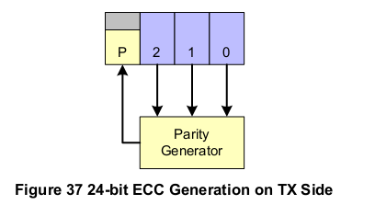
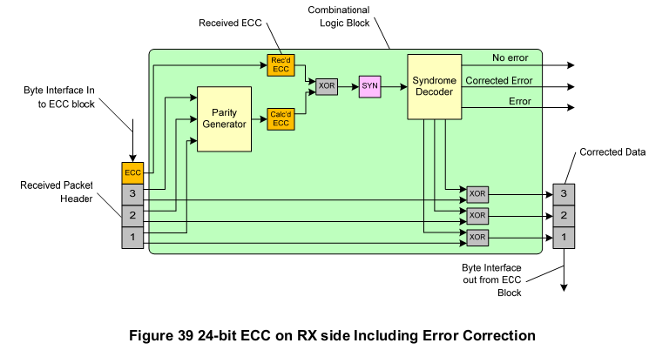
ECC generation and decoding
Notes:
Decoding the syndrome has three aspects:
1)Finding if the packet has any errors (if syndrome is 0, no errors are present) 973
2)Checking if a single error has occurred by searching Table 5, if the syndrome is one of the entries in the table, then a single bit error has occurred and the corresponding bit is affected, thus this position in the data stream needs to be complemented. Also, if the syndrome is one of the rows of the identity matrix I, then one of the parity bits are in error. If the syndrome cannot be identified, then a higher order error has occurred and the error flag will be set (the stream is corrupted and cannot be restored).
3)Correcting the single error detected, as indicated above.

Slide 42
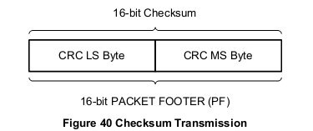
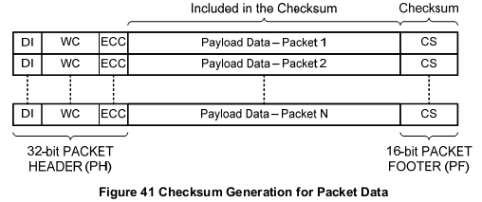
CRC check sum Generation
Transmission (LSB first)
Generation

Slide 43
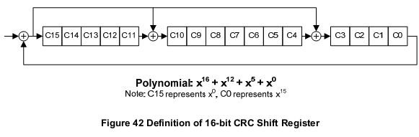
CRC check sum Generation

Slide 44
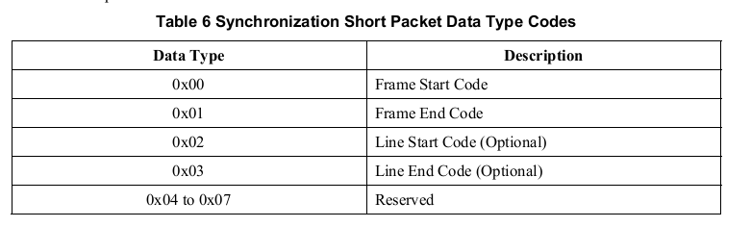
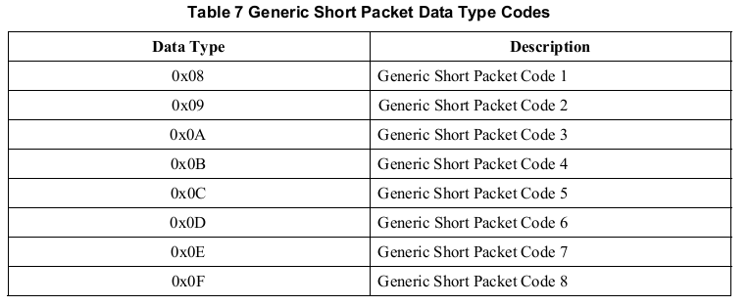
Synchronization and generic Short Packet Data Type Codes

Slide 45
Synchronization and generic Short Packet Data Type Codes
Frame Synchronization Packets
Begin with a Frame Start (FS) Packet
One or more long packets containing image data
Zero or more short packets containing synchronization Codes
End with a Frame End(FE) Packet
Same frame number for FS and FE
Frame number shall be always zero (inoperative) or increments by 1 for every FS pack et with the same Virtual Channel and is periodically reset to one e.g. 1, 2, 1, 2, 1, 2, 1, 2 or 1, 2, 3, 4, 1, 2, 3, 4（non- zero value）

Slide 46
Synchronization and generic Short Packet Data Type Codes
Line synchronization Packets
Optional
Same 16-bit line number for Line Start (LS)，Line End(LE) to a given line
Logical line numbers ，not necessarily equal to the phycical line numbers
Line number always zero or always non-zero
For progressive scan, line number increments by one within the same Virtual Channel and the same Date type. The line number Reset to one for the first LS packet after a FS packet.
For interlace scan, line number increase by the same arbitrary step value greater then one for every LS packet within the same Virtual Channel and the same Date type。The line number reset to a none-zero arbitrary start vale for the first LS packet after a FS packet.

Slide 47
Synchronization and generic Short Packet Data Type Codes
provide a mechanism for including timing information for the opening/closing of shutters, triggering of flashes, etc within the data stream
pass a data type value and a 16-bit data value from the transmitter to application layer
receiver shall pass the data type value and the associated 16-bit data value to the application layer.

Slide 48
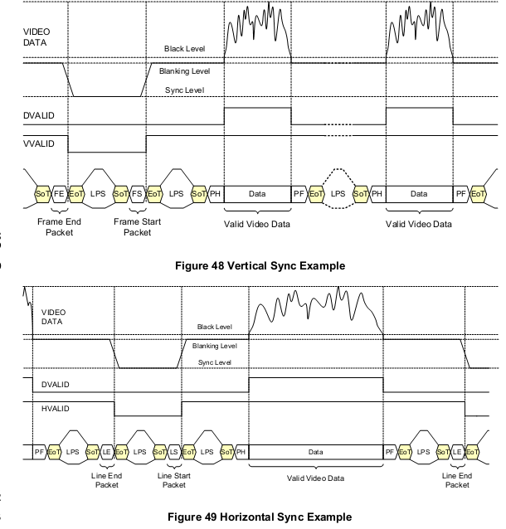
Low level protocol packets examples

Slide 49
Packet Data Payload Size Rules
YUV,RGB,RAW ,one long packet contain one line of image data.
Equal length within the same virtual Channel.
(YUV420 is an exception)
For User Defined Byte-based Data type, long packets can have arbitrary length
Total size of data within a long packet shall be a multiple of eight bits

Slide 50
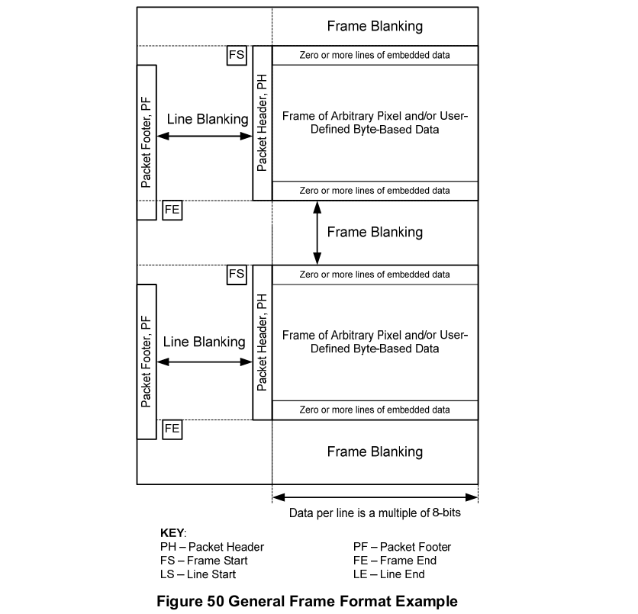
Frame format example

Slide 51
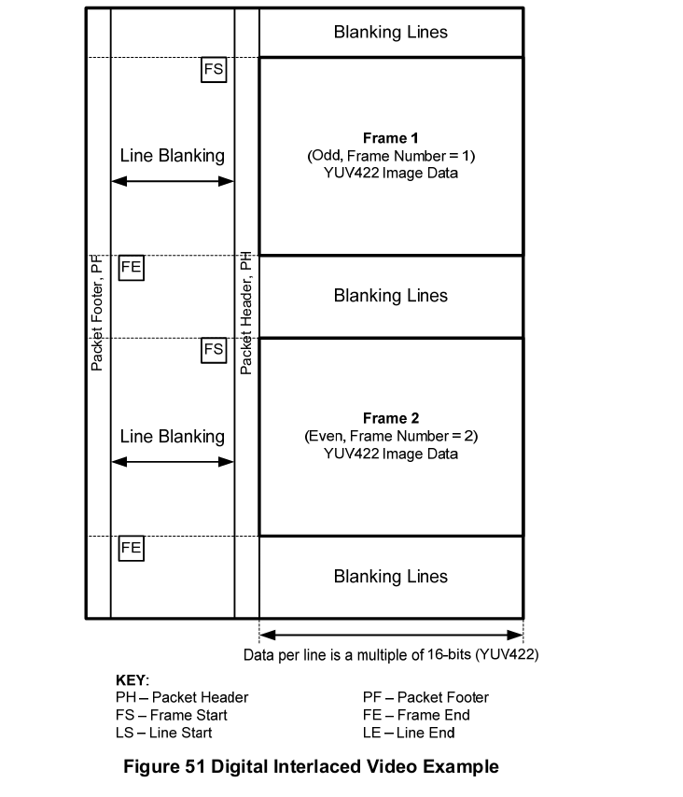

Slide 52
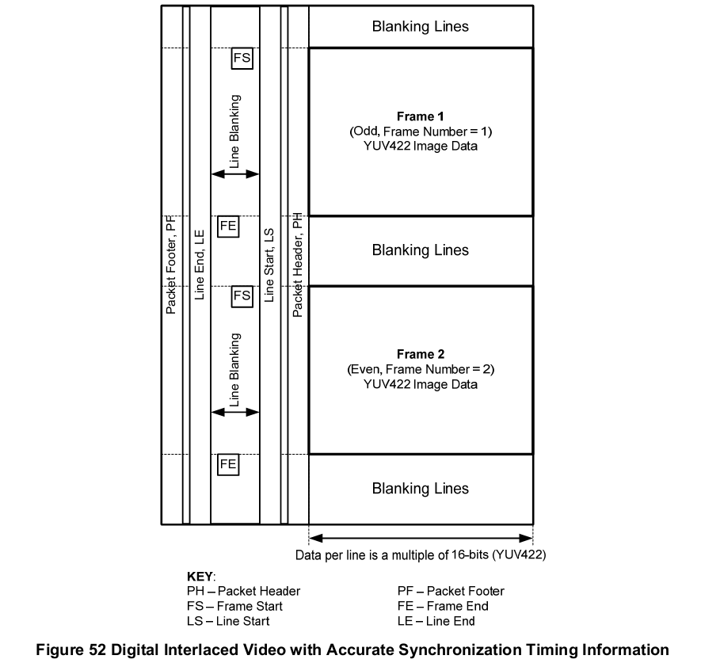

Slide 53
Color space
Reference to other standards, not limited to the reference given
RGB
sRGB in IEC61966
YUV
8-bit gamma corrected YCbCr color space defined in ITU-R BT601.4

Slide 54
Data formats
Transmitter should support at least one of the PRIMARY formats
Receiver should support all of the primary formats.
The packet payload data format shall agree with the Data Type value in the Packet Header.

Slide 55
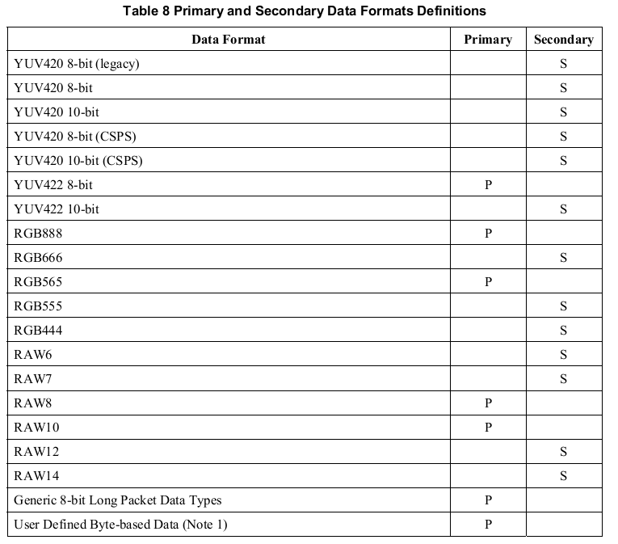
Data formats definition

Slide 56
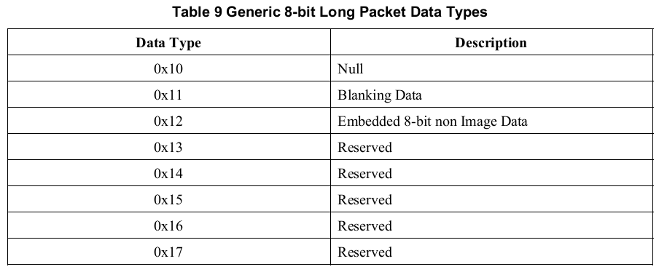
Generic 8-bit long Package data types
Notes:
Null packet has no meaning
Blanking Data uses as blanking lines (BT656 style video system)

Slide 57
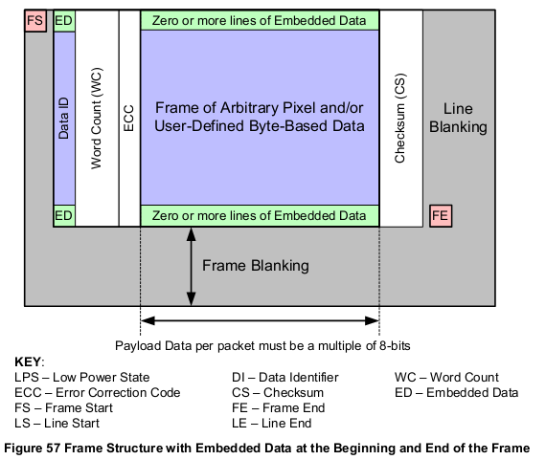
Embedded Data

Slide 58
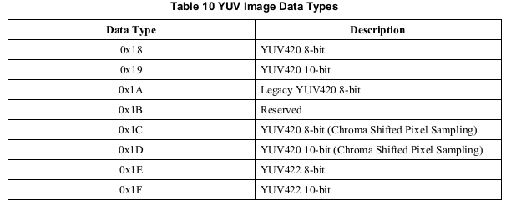
YUV image data types

Slide 59

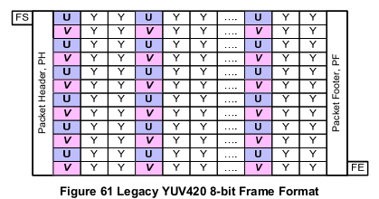
YUV image data layout

Slide 60
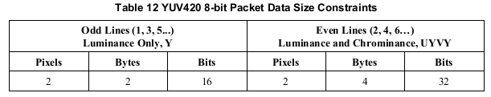
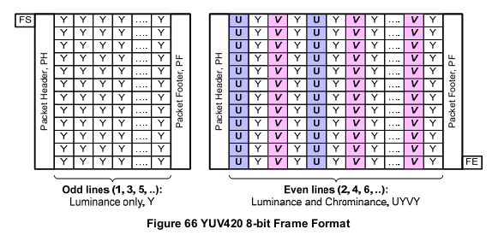
YUV image data layout

Slide 61
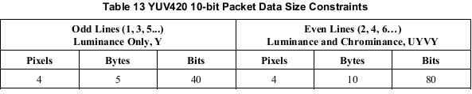
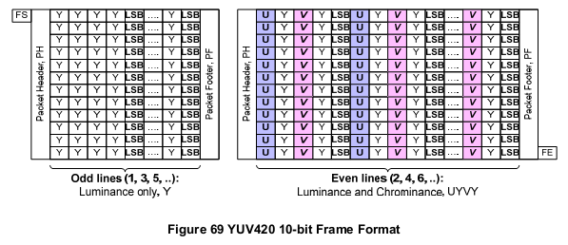
YUV image data layout

Slide 62

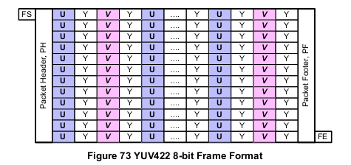
YUV image data layout

Slide 63

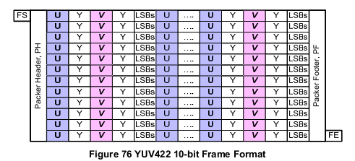
YUV image data layout

Slide 64
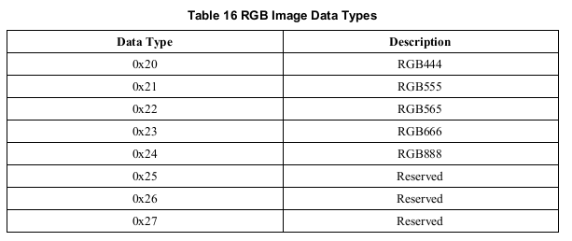
RGB Image Data types

Slide 65

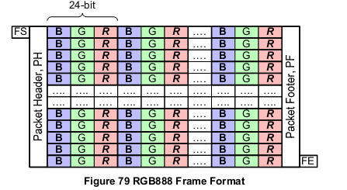
RGB image data layout

Slide 66

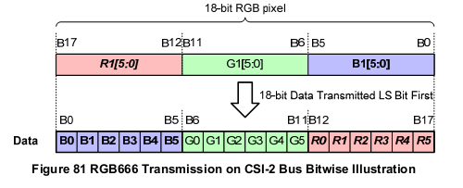

RGB image data layout

Slide 67


RGB image data layout

Slide 68


RGB555 and RGB444

Slide 69

RAW Image Data Type

Slide 70


RAW image data layout

Slide 71


RAW image data layout

Slide 72


RAW image data layout

Slide 73


RAW image data layout

Slide 74


RAW image data layout

Slide 75


RAW image data layout

Slide 76


User defined 8-bit Data Types

Slide 77


Transmission of user Defined data

Slide 78
CSI-2 in GL5202/3
Feature
Compliant with CSI-2 Spec version 1.0 and D-PHY Spec V0.9
80Mbps to 1Gbps synchronous
Low-Power Mode: space one-hot encoding for data
Ultra low power support
Data type: YUV422-8bit, RGB565, RGB888, RAW8, RAW10
1-4 Data Lanes Configurable

Slide 79

Block diagram

Slide 80

System clock
ByteClkHs = ¼ *CSI DDR clock (2 bit per clock/8bit per byte)
CSI2_CLK > ByteClkHs*Lane_num/2 (16bits per CSI2_CLK)
For 1Gbps , 4lane
ByteClk = ¼*500 = 125MHz
CSI2_CLK = 250MHz

Slide 81

Interface with ISP

Slide 82

Power-up Initialization sequence

Slide 83


Slide 84


Slide 85


Slide 86

configuration
1 to 4 Data lanes and 1 Clock lane
When configured to 1 data lane ,Data lane0 default to be activated。
Data lane module: Unidirectional slave and a CIL-SUYN function(CIL-SFEN in CSI-2 spec)
Clock lane module: Unidirectional Slave and a CIL-SCNN function

Slide 87



Slide 88
PHY level process
Data lane states
Stop State
ULPS State
SOT-Wait State – HS is on, and the PHY looks for an SOT sync pattern
SOT-Detect – SOT sync pattern was detected, possibly with a single(corrected) error, and the packet is being transferred.
Hard Error – an irrecoverable error has occurred.
Clock lane states
Stop State
ULPS State
SOT-Wait State – HS is on
Hard Error – an irrecoverable error has occurred (such as clock-miss or false clock control).

Slide 89

PHY level process

Slide 90
Packet level process
Four states
Off – no packet is being received
A packet is being received; no errors detected so far
A packet is being received; a Soft Error has been detected and corrected
A Hard Error has been detected
Soft Error :
Soft Error from PHY Level
A single (corrected) ECC error when ECC is enable
Hard Error :
Hard Error from PHY Level
ERR_ECC : A double-ECC error when ECC is enable
ERR_CRC : A CRC error when CRC is enable
if Hard Error state is reached, the state machine will stay there until cleared by the CPU.

Slide 91
Protocol Level Process
States
Idle
Frame OK state
Soft Error State
Hard Error state
Soft Error
Soft error from phy level and packet level
Hard Error
Hard Error from phy level and packet level
ERR_ID
EFS, FE after FE, FS after FS
LFS, LE after LE, LS after LS
if Hard Error state is reached, the state machine will stay there until cleared by the CPU.

Slide 92
Interrupt sources
Hardware Error interrupt
Short packet received interrupt
Context x( x = 0 or 1) event complete interrupt (corresponding FE of the context is received)
Soft error only setting Pending bits, no interrupt .

Slide 93

Operation model

Slide 94
D-PHY information related to CSI
Diagram
Line level , lane states and working mode
Mode and state machines
Error

Slide 95
D-PHY information related to CSI
Diagram
Line level , lane states and working mode
Mode and state machines
Error

Slide 96

Diagram D-PHY lane module functions

Slide 97
D-PHY information related to CSI
Diagram
Line level , lane states and working mode
Mode and state machines
Error

Slide 98


D-PHY Signal/line levels

Slide 99

Lane states
Burst mode (high speed)
Differential 0, differential 1
Control mode(low power)
Bridge
HS_rqst
LP_rqst
Stop
Escape mode(low power)
Space
Mark-0
Mark-1

Slide 100
D-PHY information related to CSI
Diagram
Line level , lane states and working mode
Mode and state machines
Error

Slide 101

Burst mode

Slide 102


Slide 103



Slide 104



Slide 105
Escape mode
A special mode of operation for Data Lanes using Low-Power states.
The PHY in Escape mode shall apply Spaced-One-Hot bit encoding for asynchronous communication.
Escape mode Entry procedure (LP-11, LP-10, LP-00, LP-01,LP-00).

Slide 106

Space one-hot coding
Space one-hot coding each mark state interleave with a space state

Slide 107

Escape Entry codes

Slide 108
Remote Triggers
To send a flag to the protocol at the receiving side
Triggers can be used for any purpose by the
Protocol layer

Slide 109

LPDT(low-power data transmission)
clock can be variable
Self clock by the applied bit encoding and does not rely on the clock lane.
Paused by “space” line state
Return to the stop state at the end

Slide 110
Ultra-Low power state
Enter by sending Ultra-Low power state entry command.
In the space state (LP-00)
Be exited by means of a Mark-1 state with a length Twakeup followed by a stop state

Slide 111

Escape mode state machine

Slide 112



Slide 113



Slide 114


Slide 115


Slide 116

Clock lane high speed state machine

Slide 117

Clock lane high speed state machine

Slide 118

Clock lane high speed state machine

Slide 119

Clock lane ultra-low power state machine

Slide 120

Data lane state diagram

Slide 121

Clock lane state diagram

Slide 122
D-PHY information related to CSI
Diagram
Line level , lane states and working mode
Mode and state machines
Error

Slide 123
Error
ERRORs
SoT Error (Leader sequence error)
SoT Sync Error (corrupted in a way that proper synchronization cannot be expected)
EoT Sync Error (a transmission does not match a byte boundary)
Escape Entry Command Error (unknown command)
LP Transmission Sync Error (data is not synchronized to a Byte boundary)
False Control Error (not correctly followed)
Watchdog timer
HS RX Timeout (no EOT)
HS TX Timeout (max length)
Escape Mode Timeout （Escape silent ）
Escape Mode Silence Timeout
Turnaround errors

